Slide 1







Table of Contents
01
02
03
Business Goals
Modeling &
Performance Evaluation
Data Preprocessing &
Feature Engineering
04
05
06
07
Business Recommendations
Return on Investment
Conclusion
Future Improvement

Slide 2

Business Goals
What business problems are we trying to solve, and what kind of solutions are we providing
Image Source:
hazards magazine

Slide 3
Problems & Solutions
Business Problem:
When employees attempt suicide, they cost companies money in the following ways:
1. Medical Costs (Hospitalization) and/or Compensation(Death)
2. Post-traumatic Stress Syndrome Training for other employees
3. Hurt Brand Images (Potential loss of existing employees, talents who could be onboard or customers)
Business Solution:
We want to save companies costs and improve employees' productivity, leading to increased profits.
We build a suicide prediction tool that predicts employees' intentions to suicide pre-emptively based on text data. Text classification identifies whether or not a person would commit suicide. Topic modeling identifies workers' flag behaviors or emotions related to mental health concerns, and companies can implement interventions to ensure corporate efficiency.
Suicides cases raise at work between 2018 and 2020, according to a report by the Bureau of Labor Statistics. Suicides occur most often among people in their working years of 24 to 64 years old.

Slide 4
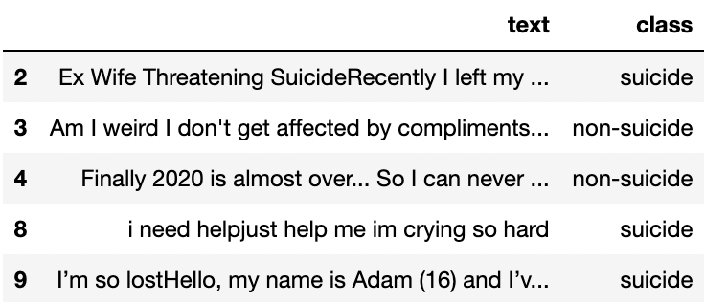
Our Data
Source | The dataset is a collection of posts from "SuicideWatch" and "depression" subreddits of the Reddit platform. The posts are collected using Pushshift API. All posts that were made to "SuicideWatch" from Dec 16, 2008(creation) till Jan 2, 2021, were collected while "depression" posts were collected from Jan 1, 2009, to Jan 2, 2021.
Features | The dataset displays a text column and a class column (suicide, non-suicide)
Number of Observations | 232,074

Slide 5

Data Preprocessing &
Feature Engineering
Image Source:
SolveXia

Slide 6
Data Preprocessing
Translate emoji to English description
Remove stopwords
Regex cleaning
Lemmatization
For better interpretation, we replaced emojis with their English names (ex. 😭 → “loudly crying face”)
We removed NLTK (Natural Language Toolkit)'s default list of english stopwords and some unmeaningful punctuations like “.” “,”
‘_WORK_’:
jobs?|career|intern(ship)?|position
‘_INTERPERSONAL_’: co(\-)?worker|interpersonal|managers?|boss|supervisor|colleague|employees?|staffs?|network
We used lemmatization over stemming because it converts words to their meaningful base forms.
(ex. ‘Caring’ -> ‘Care’ rather than ‘Car’)

Slide 7
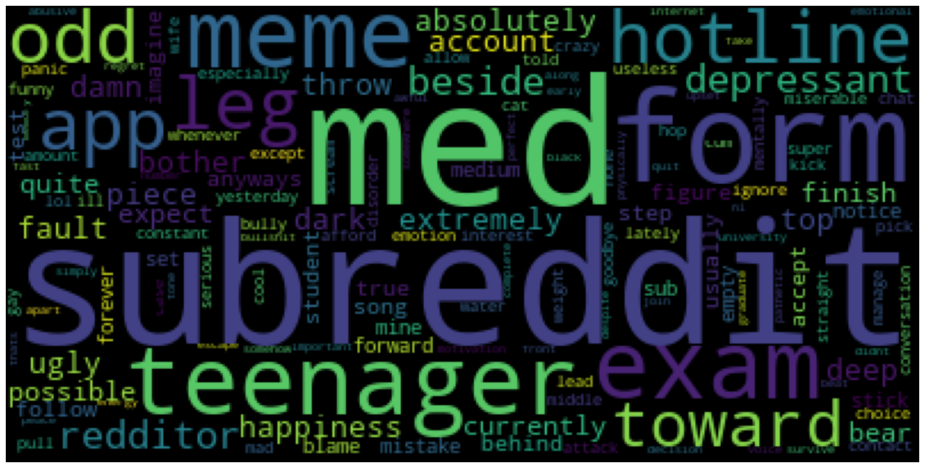
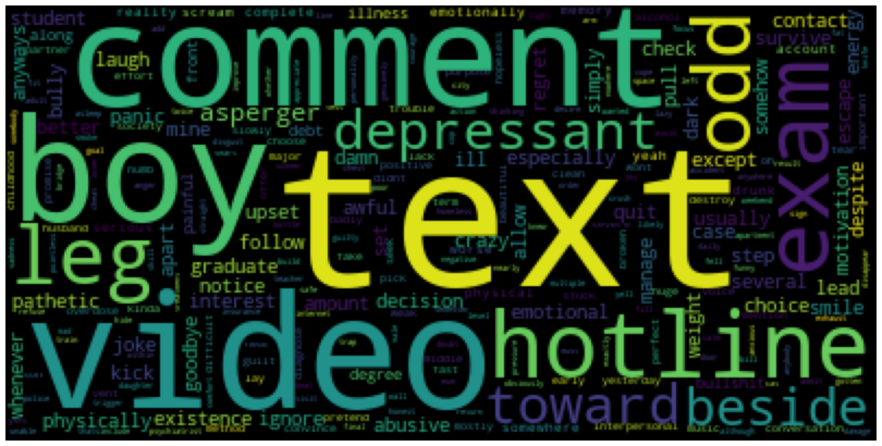
Word Cloud by all people after Pre-processing
subreddit
med
teenager
form
meme
Word Cloud by Suicide People after Pre-processing
text
comment
video
boy
hotline

Slide 8
Topic Modeling
Bigram
non-suicide | suicide
high school | want die
want die | like shit
suicidal thoughts | want end
want live | want kill
feel better | need help
… | …
Trigram
non-suicide | suicide
smile face sunglass | wan na talk
cool smiling face | wan na chat
loudly crying face | bored wan na
face rolling eyes | loudly crying face
face tears joy | wan na die
… | …
Non-suicide: some negative expression but want live
Suicide: nearly all negative words
Non-suicide: lots of positive emojis
Suicide: negative emojis, desire of communication

Slide 9

Modeling &
Performance Evaluation
Image Source:
GoodData

Slide 10
Model Exploration & Architecture
Bert Tokenizer
Train/Test Sets 50-50 Split
Model Exploration
Logistic (baseline)
Random Forest
LightGBM
XGBoost
CatBoost
Bert
Logistic Regression
In this algorithm, the probabilities describing the possible outcomes of a single trial are modelled using a logistic function.
Random
Forest
A meta-estimator that fits a number of decision trees on various sub-samples of datasets and uses average to improve the predictive accuracy of the model.
LightGBM
A fast, distributed, high-performance gradient boosting framework based on decision tree algorithm, used for ranking, classification, etc.
XGBoost
A scalable, distributed gradient-boosted decision tree (GBDT) machine learning library that provides parallel tree boosting.
CatBoost
It provides a gradient boosting framework which among other features attempts to solve for Categorical features using a permutation driven alternative compared to the classical algorithm.
Notes:
Reference:
https://analyticsindiamag.com/7-types-classification-algorithms/
https://towardsdatascience.com/lightgbm-vs-xgboost-which-algorithm-win-the-race-1ff7dd4917d
https://www.nvidia.com/en-us/glossary/data-science/xgboost/
https://en.wikipedia.org/wiki/Catboost

Slide 11
Model Exploration - Bert
01
BertTokenizer
Use BertTokenizer from pre-trained and set truncation, MAX_LEN = 50, and batch_size = 32
02
Bert Classification
Bert
Use BertForSequenceClassification from pre-trained
which stands for Bidirectional Encoder Representations from Transformers
Optimizer & Parameters
Optimizer: AdamW(lr=2e-5, correct_bias=False)
AdamW: a variant of the optimizer Adam that has an improved implementation of weight decay which is a form of regularization to lower the chance of overfitting
Parameters (109,483,778 trainable parameters)
weight_dacay_rate
03
04
Evaluation Function
Accuracy & Loss

Slide 12
Model Performance
L
R
L
X
C
B
71.8%
77.1%
82.2%
85.7%
85.7%
97.4%
Logistic
(Baseline)
Random Forest
LightGBM
XGBoost
CatBoost
Bert
Accuracy:
0.7177
Average Runtime:
7.21 s
Accuracy:
0.7707
Average Runtime:
1 min 31 s
Accuracy:
0.8223
Average Runtime:
8.45 s
Accuracy:
0.8574
Average Runtime:
1 min 40 s
Accuracy:
0.8573
Average Runtime:
1 min 45 s
Accuracy:
0.9740
Average Runtime:
28 min 23 s

Slide 13

Business
Recommendations
Image Source:
Make a Difference

Slide 14
Model Implementation Overview
ML Model
Suicide Detection
Our model gives high accuracy predicting potential suicide (XGBoost & CatBoost: 85.7% R²)
Implement an intelligent suicide detection product using NLP and ML classification methods
Business Mental Health Program
Financial Benefits
Safe Workplaces
Increases working efficiencies of employees and saves medical costs for the company
Boosting the happiness of employees establishes positive company image in the long run

Slide 15
Implementation Roadmap
As Facebook is using AI in the realm of suicide prevention, many tech companies are also looking for novel tools for predicting suicide. Our Suicide Prediction Tool can mine online posts(social media, blogs, etc.) or messages from workplace communication tools for words linked to suicide and identify flag behaviors or emotions to alert the companies of their employees’ mental health issues.
Suicide Prediction Tool Use
01
Suicide prediction tool can be incoporated to the Workplace Suicide Prevention Program in companies. Once a flagging suicidal behavior or emotion is identified by the tool, the program will promote help-seeking and help-giving to the targeted employee at the workplace.
Workplace Suicide Prevention Program
02
Improvement & Concern
Since we build our tool based on posts on Reddit that are not only posted by employed people, we would like to collect more employee data in the future and rebuild our tool. Also, using online data for suicide prediction is still subject to oversight and review to ensure its effectiveness, safety, and ethical permissibility.
03

Slide 16

Return on Investment
Image Source:
Talk space

Slide 17
Return on Investment
Enough data on the cost of inpatient psychiatric care for suicidality, police and EMS response, crisis institutes, and so on. Allocation of human resources that includes data cleaning and time for model making.
Based on existing research literature, we estimate that each year of investment in the suicide prediction tool will at least prevent 3,600 suicide attempts and 140 deaths over the next 28 years. This leads to a reduce of 0.13% in the number of suicide attempts and deaths. We project the financial benefits of stoping these attempts and deaths to be $1,100 per dollar invested in the tool. These benefits include savings in medical costs and increased profits.
Costs
Roadmap for implementation
Benefits
Risks
Implement suicide prediction tool in the company and incorporate it to Workplace Suicide Prevention Program. Once high risk people are identified, provide follow-ups or cognitive behavioral therapy. The researchers found that both interventions could be cost-effective as long as the models used to predict suicide risk have a high degree of accuracy.
The results may not be applicable to other geographies or populations, and the correlations described by the results are only applicable to the particular data sets used within the specified location.

Slide 18

Conclusion
Image Source:
Tesis Master

Slide 19
Conclusion
Advanced NLP techniques can create business opportunities and identify potential suicidal actions at workplaces.
Bert Model gives the highest classification accuracy of 97.4%, but it also has the longest runtime of 28 min 23 s. This could be implemented into businesses’ mental health program or a suicide detection product that can be widely used.
By looking at the result of model performance, we can promote help-seeking and reduce the incidence of suicide and suggest suicide-prevention campaigns.
Suicide prediction can result in significant potential cost savings as a result of fewer suicide deaths and reduced life years lost.

Slide 20

Future Improvement
Image Source:
accounting web

Slide 21
Future Improvement
For efficiency, we would like to try fasttext, DistilBert, FastBert and so on.
For accuracy, we would like to try more advanced models which are improved based on Bert such as RoBerta, DeBerta-V3.
Finally, we would like to find the balance (Trade-offs) between efficiency and accuracy.
More
Model
Explorations
1
Tune
Parameters
2
We did not have enough time to tune parameters. Hence, we would like to tune parameters to control running time, limit overfitting, and improve accuracy in the future.
Automatic Pipelines
3
Functionalize things, automate workflows and create pipelines to deal with streaming data.

Slide 22
Reference
https://analyticsindiamag.com/7-types-classification-algorithms/
https://towardsdatascience.com/lightgbm-vs-xgboost-which-algorithm-win-the-race-1ff7dd4917d
https://www.nvidia.com/en-us/glossary/data-science/xgboost/
https://en.wikipedia.org/wiki/Catboost
https://healthitanalytics.com/news/suicide-risk-prediction-models-prove-cost-effective-in-healthcare
https://www.rand.org/pubs/periodicals/health-quarterly/issues/v5/n2/09.html

